Slide 1
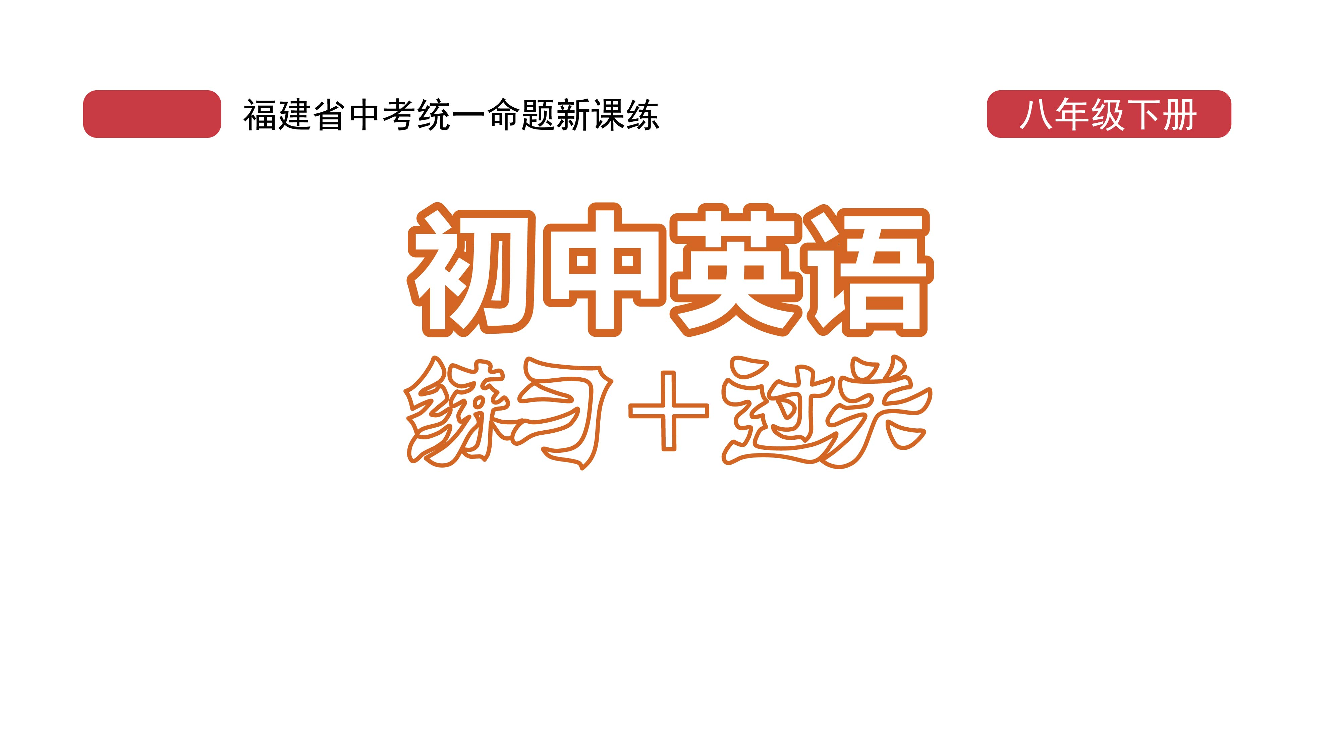
课时练习
模块五 第二章 读写综合训练

Slide 2
一、完形填空。
My grandpa always tells me that people who laugh at their own mistakes will get others to laugh along. Yesterday, I learned that he was 1 .
“Stay in line,” Mrs. Martin said. I looked at the long line, 2 that there would still be pizza. When I got to the front, I looked at the food. I could only see chicken, fish and mashed potatoes(土豆泥).
1. A. funny B. right C. clever
2. A. wondering B. worrying C. hoping
B
C

Slide 3
一、完形填空。
A
I could hear the sad noise of my 3 .
Then, out of the corner of my eye, I saw the 4 .piece of beef pizza. I got so excited and felt so lucky.
“Beef pizza, please,” I said politely. Mrs. Martin handed me the pizza. I took the paper plate
3. A. stomach B. head C. mouth
4. A. last B. best C. largest
A

Slide 4
一、完形填空。
B
A
so 5 that the pizza fell out. I wanted to 6 it, but it landed on the mashed potatoes. My face started burning. All I could hear were 7 from some kids in line.
As I looked at the upside-down pizza, I heard Mrs. Martin’s voice. “Maria, would you like some
5. A. carefully B. quickly C. sincerely
6. A. catch B. eat C. throw
7. A. shouts B. cheers C. laughs
C

Slide 5
一、完形填空。
mashed potatoes to go with your pizza?” I said in a(n) 8 voice, “Of course.” Mrs. Martin put the mashed potato pizza on my 9 with an encouraging(鼓励的) smile. I suddenly woke and relaxed. I looked around laughing, and we all laughed together.
8. A. angry B. nervous C. friendly
9. A. plate B. hand C. table
B
A

Slide 6
一、完形填空。
I never really believed my grandpa until I saw others laughing with me. The laughing made me feel 10 instead of just stupid.
10. A. hurt B. helpless C. good
C

Slide 7
二、阅读理解。
If you feel sad or upset, remember not to watch a happy movie. A sad movie may be just what you need. Some scientists at Ohio State University, the US, have found that sad movies can make people happier. They published their study in a magazine called Communication Research.

Slide 8
二、阅读理解。
The scientists asked 361 college students to watch a sad movie called Atonement. The movie tells a story of two lovers who were separated(分离) and finally died during World War Ⅱ. The scientists asked the students questions before, after and three times during the movie to find out about their emotions(情绪), including sadness.

Slide 9
二、阅读理解。
Scientists found out that people felt better after watching the sad movie. They believed this was because the movie made people think about their own lives and relationships(关系). Their lives, compared(对比) to those of the unlucky lovers in the movie, were full of hope.
“I want to live my life to the fullest, and this movie has made me think a lot,” one student wrote.

Slide 10
二、阅读理解。
Silvia Knobloch-Westerwick, the leader of the study, explained that negative(消极的) emotions make people more thoughtful. “Positive emotions are generally a sign that everything is fine. You don’t have to worry, and you don’t have to think about problems in your life,” she said.

Slide 11
二、阅读理解。
“But negative emotions, like sadness, make you think more about your situation. So, seeing a sad movie may make you sad, but that will cause you to think more about your own close relationships and appreciate(重视) them more.”

Slide 12
二、阅读理解。
( )1. The scientists asked the college students to watch Atonement _______.
A. to help them make more friends
B. to make them feel better about themselves
C. to find out how they felt after watching it
D. to encourage them to share their feelings
C

Slide 13
二、阅读理解。
( )2. How many times did the students answer questions from the scientists?
A. Six times. B. Five times.
C. Four times. D. Three times.
B

Slide 14
二、阅读理解。
( )3. What does the underlined word “those” in Paragraph 3 refer to?
A. Stories. B. Feelings.
C. Friends. D. Lives.
D

Slide 15
二、阅读理解。
( )4. Which of the following is TRUE according to the passage?
A. Seeing a sad movie will make you sadder.
B. Seeing a sad movie makes you more thoughtful.
C. Negative emotions are bad for your health.
D. Positive emotions make people think a lot.
B

Slide 16
二、阅读理解。
( )5. What is the best title for this passage?
A. Feeling sad? Watch a sad film
B. Feeling lonely? Find true love
C. Feeling bad? See a happy film
D. Feeling down? Think about others
A

Slide 17
三、短文填空。
Leo and his father hadn’t talked for 10 years. 10 years ago, Leo’s mother died and he 1 . (think) it was his father who caused his mother’s illness. He hated his father.
One day, they were sitting in a nice 2 . shop. Suddenly his father asked the waiter to put some salt in his coffee. Leo was surprised.
thought
coffee

Slide 18
三、短文填空。
His father smiled and said, “Before you were 3 ./bɔː(r)n/, your mother and I often had fun 4 .(play) in the sea. We tasted the sea, and it tasted like the salty coffee. Every time I have salty coffee, I always think of your mother. I 5 ./mɪs/ her so much.”
Leo was deeply moved. He never knew his father had such deep love for his mother.
born
playing
miss

Slide 19
三、短文填空。
with
One month later, he moved to live 6 his father. Every time he made coffee for him, he put some salt in the coffee.
After 10 years, his father died. Leo received a 7 ./'letə(r)/ which said, “Dear Leo, please forgive(原谅) my lie about the salty coffee. In fact,
letter

Slide 20
三、短文填空。
but
I was asking for some sugar at that time, 8 I said salt. It was hard for me to correct 9 . (me), so I just went ahead. Now let me tell you the truth(真相). I don’t like salty coffee, but I drink salty coffee for 10 years! Having you with me is the 10 .(big) happiness of my whole life.” .
myself
biggest

Slide 21
四、书面表达。
在一场车祸事故中，林洁不幸失去了父母。她很伤心，无法专心听课，也不再和同学们一起参加活动。请你以林洁朋友的身份，用英语给她提5条建议，使她重新振作起来。

Slide 22
四、书面表达。
1. _________________________________________
2. _________________________________________
3. _________________________________________
_________________________________________
4. _________________________________________
5. _________________________________________
Be brave. Everything will be fine.
You’d better listen to some soft or active music.
Why not talk about your sadness with your best friend?
You should go out and do some exercise.
Try to take part in some activities.

Slide 23


